Slide 1
C++ exception handling
By Rico Jaime, Ke Lyu, Andy Zhao,Peter Cong

Slide 2
The value of exceptions
Exceptions is a response put in place by a program to handle a predicted problem in order to control the damage caused during execution
Using exceptions in multistep large programs can also be used to make resources used in each block of code to ensure that the program don't exceed resources given.
It can also be used to contain an error if you need the program to constantly run(ex games).

Slide 3
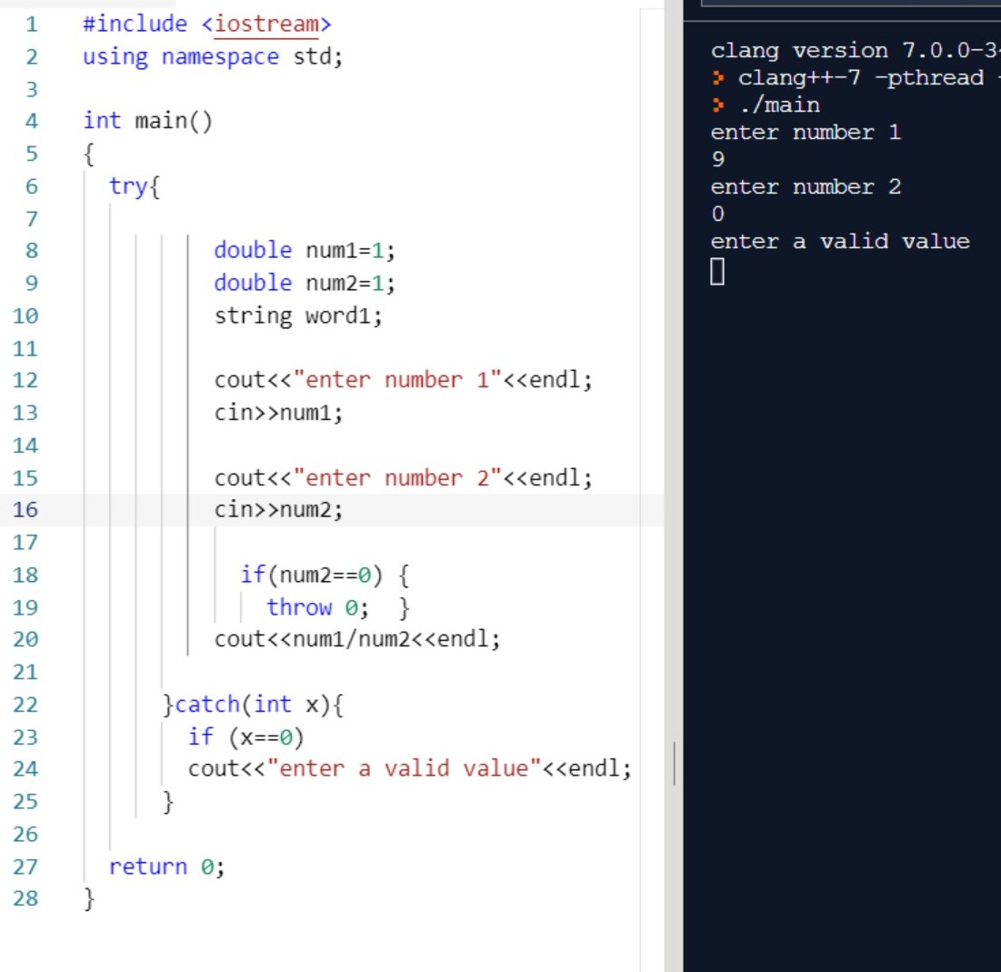
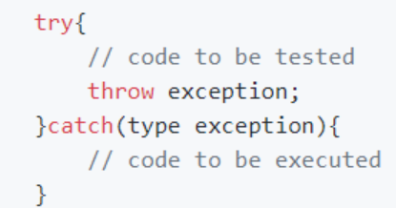
Types of exceptions and errors
try, catch, throw are the most common keywords in C++ exception handling.
We use exceptions when we have a syntax, runtime, logic or during unexpected user inputs.

Slide 4
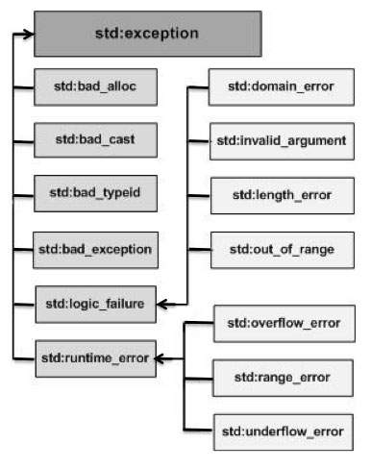
Types of exceptions
The two types of exceptions are Synchronous and Asynchronous.
Synchronous-Runs within the program and its allocated resources
Asynchronous- Error that happen that are not in our control like a hardware failure.
Exception handling is designed mostly for Synchronous operations in C++ .
Notes:
Link to example(s) https://repl.it/join/lrctwgqm-andyz

Slide 5
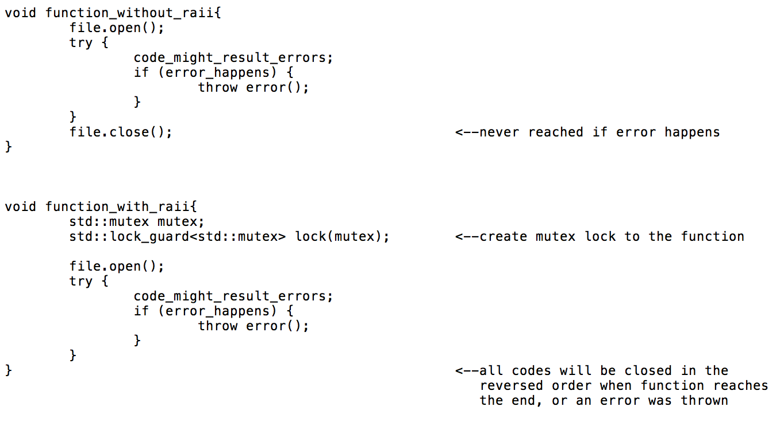
RAII
“Resource Acquisition Is Initialization’’ technique.
Binding a limited resource to the life time of the object(ex disk space,ram,cpu threads)

